Slide 1



Datacore Consultants
Decoding Success with AI : Our Algorithms, Your Growth!

Slide 2


About Us
We are a result-driven consulting organization committed to continuous learning and improvement, staying abreast of industry trends, emerging technologies, and best practices.
Our success lies in helping our clients achieve their goals while upholding the highest ethical standards.
Our team of seasoned domain experts at Datacore Consultants brings a wealth of experience in data engineering, machine learning, and advanced analytics.

Slide 3


Meet Our Speech Assistants
AI Auditor
Vaani AI
Revolutionize Audits with Generative AI
An AI-Driven Excellence in Customer Service

Slide 4
Case Study
Dependencies & Challenges in Auditing and Rating Call Center Agent Performance
Customer Satisfaction Challenges: Call centers struggle to maintain high levels of customer satisfaction. Without monitoring tools, tracking KPIs like Net Promoter Score (NPS), Call Abandonment Rate, and Customer Satisfaction Score (CSAT) becomes difficult. This leads to suboptimal service quality.
Cost Management Issues: Inefficiencies and poor performance translate to higher operational costs. Inability to measure key metrics like Cost per Call (CPC) and Service Level (SL) leads to higher expenses and reduced profitability. This hinders business growth and customer retention.
Operational Efficiency Goals: Achieving operational efficiency is a key target for businesses. Without real-time data, managers cannot identify peak call times, leading to inadequate staffing during high-volume periods. This results in longer wait times, increased customer frustration, and negatively impacts NPS and overall service quality.
Time-Consuming Process: The manual review of calls is time-consuming, leading to delays in obtaining actionable insights.
Inconsistent Audits: Human auditors may have subjective biases, leading to inconsistent evaluation of agent performance.
Agent Performance Identification: Identifying exceptional and underperforming agents is a key challenge for management. Without detailed analytics, there is a lack of insights, hampering targeted coaching efforts. This affects the Quality Score, Occupancy Rate, and compliance rates, ultimately impacting the effectiveness of the call center team.

Slide 5








How does it work?
AI Auditor
Sentiment Analysis
Revolutionize Audits Process with Generative AI
Topic Modelling
Agent Performance Metrics
AI AUDITOR
Business SLA & Insights
Existing Calling Process
Multi-Channel
Call Recordings
Dashboard
Agent Comments or Call Notes

Slide 6

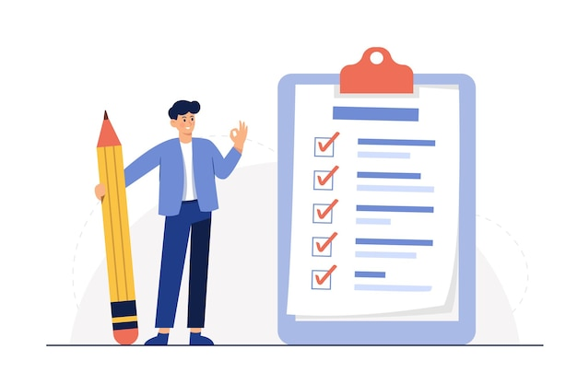


Key Features
AI Auditor
Transform Business with Cutting-Edge LLM Capabilities
Holistic Interaction Analysis:
100% comprehensive review of customer interactions across voice
Ensure no critical data is missed and gain comprehensive insights into customer experience
Ensuring SLA Achievements:
Identifying issues with soft skills, escalations, dead air, Zero Tolerance Policy (ZTP), and Average Handle Time (AHT).
Focus resources on the most impactful areas to enhance service quality.
QA Evaluation and Performance dashboard:
Generate detailed reports effortlessly for QA evaluation
Pinpoint specific improvement areas and visualize performance trends to drive targeted coaching
Enhanced Communication & Interaction Analytics:
Asses and review agent soft skills during escalation calls and identify the improvement zone for training.
Analyse the nuances of conversation, including interjection, response timing and objection handling to ensure effective solution to customer.

Slide 7
Case Study
Challenges faced by contact centres in maintaining Customer Satisfaction and Loyalty
Opportunities with Vaani AI to improve Customer Satisfaction and Loyalty
High Operational Costs: Maintaining a large team of human agents is expensive, with costs including salaries, training, and infrastructure.
Cost Reduction: By automating repetitive and low-value tasks, Vaani AI significantly reduces operational costs.
Agent Burnout: Repetitive and monotonous tasks lead to high employee burnout, impacting productivity and service quality. It also leads to high agent attrition.
Improved Agent Satisfaction: Offloading monotonous tasks to Vaani AI allows human agents to focus on more complex and rewarding interactions, reducing burnout and increases employee retention.
Scalability Issues: During peak times, it is challenging to scale human resources quickly to meet the increased call volumes.
Enhanced Scalability: Vaani AI can handle unlimited call volumes, ensuring seamless service during peak times.
Inconsistent Service Quality: Variability in agent performance can lead to inconsistent customer experiences.
Consistent Service Quality: Vaani AI provides consistent and accurate responses, enhancing overall customer satisfaction.
Negative ROI Processes: Certain processes, such as handling frequent simple queries, often result in negative ROI due to their high handling costs and low revenue impact.
Positive ROI: Automating processes with low ROI improves overall business profitability.

Slide 8


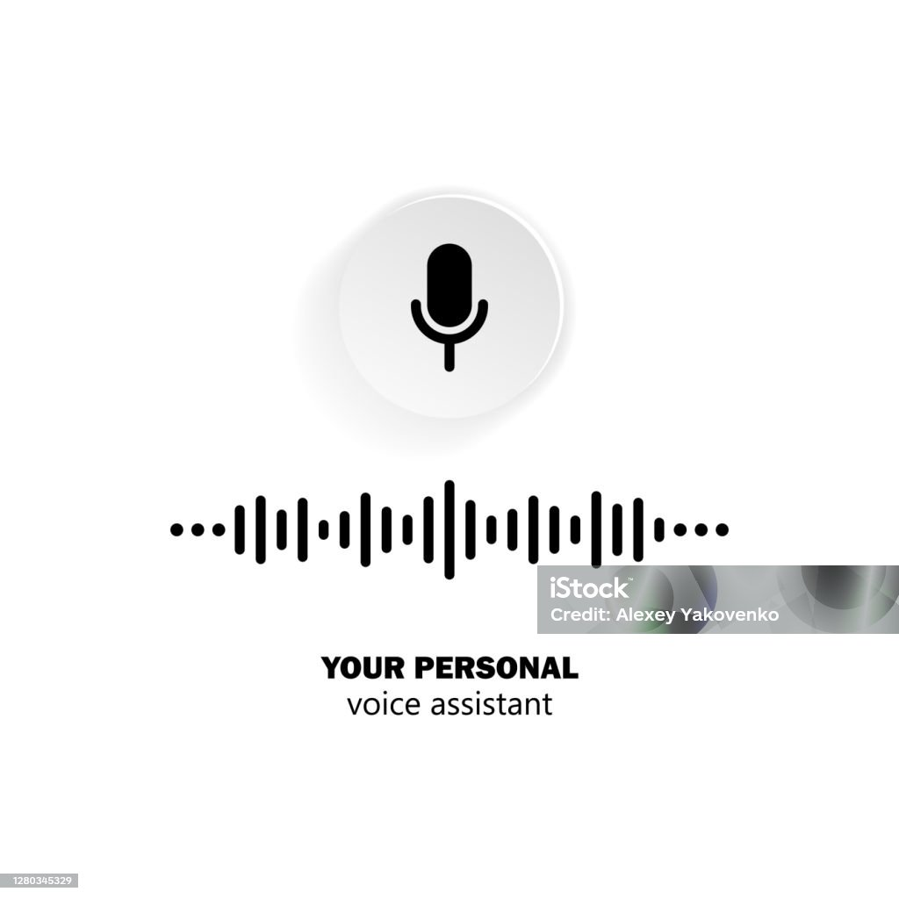

How does it work?
Vaani AI is an advanced AI-powered contact center representative designed to enhance customer service operations by automating call handling and providing real-time, human-like interactions. Unlike traditional automated systems, Vaani AI leverages state-of-the-art LLMs and Machine Learning algorithms to understand and respond to customer queries with high accuracy and empathy.
Vaani AI - Workflow
1
Speech To Text
Business Knowledge, SOP, Guidelines, etc.
2
Information Retrieval
Text To Speech
3

Slide 9
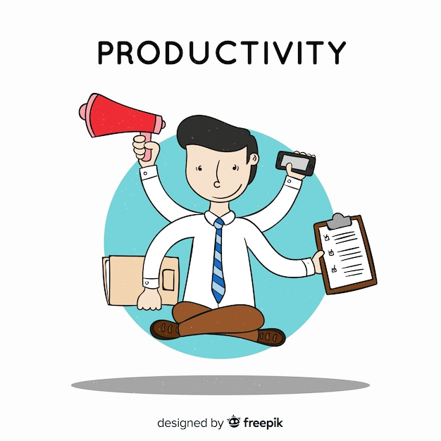
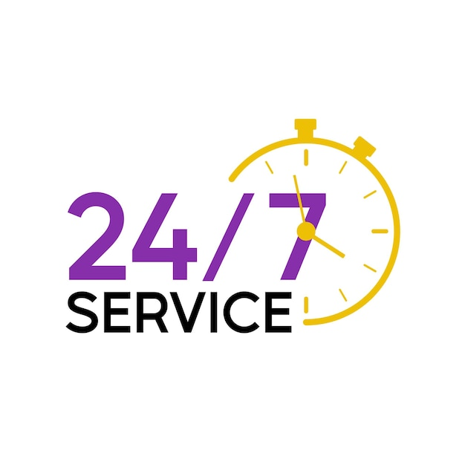

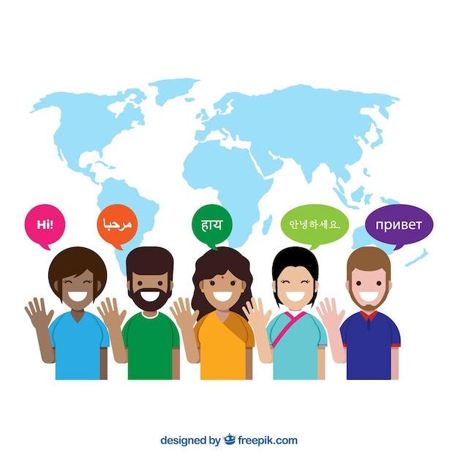

Key Features
Vaani AI
AI-Driven Excellence in Customer Service
Automating Routine Queries
Vaani AI efficiently handles routine queries, freeing up human agents for more complex tasks.
24/7 Availability
Unlike human agents, Vaani AI operates round-the-clock, providing uninterrupted customer support.
Real-Time Data Retrieval
Vaani AI can quickly access and retrieve information from business documents, ensuring accurate and timely responses.
Language and Accent Adaptation
Vaani AI is trained to understand and respond in multiple languages and accents, catering to a diverse customer base.
Scalable Solution
Whether it’s a sudden spike in calls or a need for long-term scalability, Vaani AI adjusts effortlessly to demand changes.

Slide 10
Our Vision
“In a world of limits, we see opportunities where others see barriers”
Our mission is to embrace challenges through unwavering commitment and strategic innovation, elevating the profitability of our partners with humility and resolve.

Slide 11




Contact Us
Pritesh Jha
Rahul Mishra
+91-983 311 5874
+91-897 667 0473
pritesh.jha@datacoreconsultants.com
rahul.mishra@datacoreconsultants.com
For further assistance, please reach out to our marketing team at the following:
marketing@datacoreconsultants.com
+91-897 658 1583
www.datacoreconsultants.com

Slide 12


Thank you

